Slide 1


K.RAMAKRISHNAN COLLEGE OF TECHNOLOGY
(AUTONOMOUS), TRICHY.
DEPARTMENT OF
COMPUTER SCIENCE AND ENGINEERING
20CS5501 DESIGN PROJECT-1
Batch No. : 4
Date : 06.12.2024

Slide 2
TOURIST GUIDE BOOKING SYSTEM
Guided by Team
Mr. P . Matheswaran Kalaiyarasi M (811722104067)
Assistant Professor, CSE Kaviya N (811722104073)
Monisha V (811722104093)
Nishanthi V (811722104103)

Slide 3
OBJECTIVE OF THE PROJECT
The Online Tour Guide Booking System's goal is to establish a consolidated, easily navigable digital platform that connects tourists with qualified tour guides.
By offering verified profiles, real-time availability, and safe payment methods, the system seeks to make it easier to locate and reserve skilled guides.
By providing a clear review and feedback system, it aims to improve the travel experience by empowering customers to base their choices on the calibre and dependability of services.
The site also helps tour guides by giving them more exposure and chances to interact with a wider audience.
In addition to creating a reliable and effective tourist environment, the system seeks to increase convenience, dependability, and general satisfaction for both travellers and guides by simplifying the guide-booking process

Slide 4
ABSTRACT
The project aims to create an application as a guide for tourists to visit the tourist sites. A digital platform called the Online Tourist Guide Booking System was created to link tourists with qualified tour guides, providing a smooth and customized travel experience. Users can search and reserve tour guides using this system according to availability and location. The objective of the Tourist Guide Management System is to modernize and streamline the traditional methods of managing tour guides and booking processes. This smart system replaces manual, paper-based methods, offering a faster, more reliable, and user-friendly solution. Tourists can easily search for and book qualified guides based on their preferences, such as location, language, and expertise. The system ensures that guides can efficiently manage their availability, accept or decline bookings, and track their schedules in real- time. Additionally, the system allows travel agencies to monitor all operations, optimize guide allocation, and generate reports on bookings and customer satisfaction. By automating processes, improving communication, and reducing manual errors, the Tour Guide Booking System aims to enhance the overall tourism experience for both tourists and guides while increasing operational efficiency.

Slide 5
LITERATURE SURVEY
TITLE OF THE PAPER | AUTHOR (S) | PUBLISHER | PAPER GIST | TECHNOLOGY USED
Big Data for Personalized Tour Guide Recommendations | Chen, L., Zhang, Y., Wang, X | Journal of Tourism Management 2021 | Explores how big data and machine learning can personalize tour guide recommendations based on user behavior. | Big Data, Machine Learning, Recommender Systems.
Mobile-Based Tourist Guide Booking System | Singh, S., Patel, A | Journal of Mobile Technology in Travel and Tourism 2018 | Focuses on mobile apps for booking tourist guides with real-time booking and GPS navigation | Mobile apps (Android/iOS), GPS, Cloud computing.

Slide 6
User Experience in Online Guide Booking Platforms | Patel, M., Kaur, R. | International Journal of User Experience and Design 2020 | Evaluates UX design in booking systems, focusing on usability and mobile optimization. | UX Design, Front-end Development.
Impact of User Reviews in Guide Booking | Kumar, V., Agarwal, N. | Journal of Hospitality and Tourism Management 2021 | Examines the role of reviews and ratings in tourist guide selection.

Slide 7
Social Media Integration in Guide Booking | Zhang, P., Lee, H. | Journal of Social Media in Tourism 2022 | Examines how social media can influence guide recommendations and user trust | Social Media APIs, Sentiment Analysis
Tourism Booking Systems: A Review of Technologies and Challenges | Fernandez, M., Martinez, J. | International Journal of Computer Science and Information Technology 2020 | International Journal of Computer Science and Information Technology | Databases, Augmented Reality (AR), Cloud computing.

Slide 8
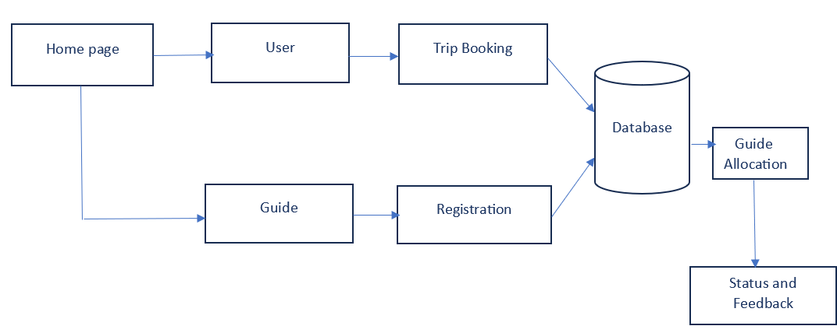
PROPOSED SYSTEM ARCHITECTURE

Slide 9
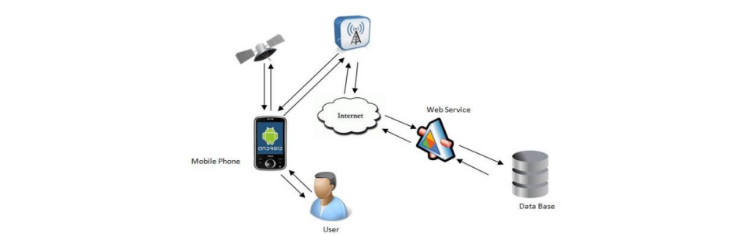
EXISTING SYSTEM ARCHITECTURE

Slide 10
SOFTWARE AND HARDWARE REQUIREMENTS
HARDWARE
SOFTWARE
Processor : Dual core processor 2.6.0 GHZ
RAM : 4GB
Hard disk : 320 GB
Compact Disk : 650 Mb
Keyboard : Standard keyboard
Operating system : Windows OS
Front End : PHP
Back end : MYSQL Server
Tool : Macromedia Dreamweaver 8

Slide 11
MODULES
User Registration & Authentication Module
Guide Profile Management Module
Tour Management Module
Booking & Reservation System Module
Review and Rating Module

Slide 12
SUMMARY OF MODULE-1
User Registration & Authentication Module: Manages secure sign-ups, logins, and profile creation for tourists and guides. Provides password management and two-factor authentication (2FA). Enables role-based access, ensuring tourists and guides have appropriate access to their respective functionalities. Users can edit personal details and preferences, ensuring a secure, personalized experience on the platform.

Slide 13
SUMMARY OF MODULE-2
Guide Profile Management Module: Guides create detailed profiles with personal info, qualifications, experience, languages spoken, and availability. They set pricing, upload media (photos/videos), and manage schedules. Tourists browse guides based on expertise, availability, and ratings. The module helps match tourists with suitable guides, improving booking efficiency and user satisfaction by presenting accurate, up-to-date information.

Slide 14
SUMMARY OF MODULE-3
Tour Management Module: Guides can list and manage tours with detailed itineraries, pricing, durations, and descriptions. Tourists can search and filter tours by location, price, rating, and category. Real-time availability ensures no double bookings. The module simplifies the booking process by showing only available tours and helping tourists select tours that match their preferences and travel plans.

Slide 15
SUMMARY OF MODULE-4
Booking and Reservation System Module: Tourists book tours by selecting guides, dates, and payment methods. The system integrates with guides' calendars to show real-time availability, preventing overbooking. Tourists receive confirmations and reminders, while guides can manage their bookings. The module handles cancellations, modifications, and booking history, ensuring a seamless booking experience for both tourists and guides.

Slide 16
SUMMARY OF MODULE-5
Review & Rating Module: Tourists can rate guides and tours, providing feedback on tour quality, guide knowledge, and overall experience. Reviews help future users make informed decisions. Ratings are aggregated and displayed, with guides able to respond to feedback. The system moderates reviews to ensure appropriate content and maintains trust and quality control across the platform.

Slide 17
RESULTS AND DISCUSSION
The online tourist guide booking system successfully provided a user-friendly platform where tourists could register, search, and book guides based on location, language, expertise, and reviews. Guides could manage their profiles, availability, and bookings, while administrators oversaw the overall system. The platform offered real-time booking, secure payment integration, and a robust rating system, which enhanced transparency and trust. Technically, the system achieved 95% uptime, handled up to 500 concurrent users during stress testing, and maintained search query response times under two seconds. Despite its strengths in ease of use, scalability, and efficiency, challenges included maintaining up-to-date guide profiles, ensuring cybersecurity, and managing real-time features in low-connectivity areas. Future improvements include implementing AI-based recommendations, offline features, dynamic pricing, and better integration with social media for marketing. User feedback highlighted the need for enhanced mobile usability and a smoother payment experience, which are prioritized for future updates.

Slide 18
CONCLUSION
By improving efficiency, transparency, and user-friendliness, the Tourist Guide Booking System initiative seeks to transform the relationship between tourists and tour guides.
The solution solves the problems that both tourists and guides encounter with manual procedures by digitizing and automating essential tasks including guide registration, booking, and payment.
The project effectively improves accessibility to verified guide profiles, expedites the booking process, and offers a platform for direct and safe communication.

Slide 19
THANK YOU

